Slide 1


Guidance in Radiology Report Summarization: An Empirical Evaluation and Error Analysis
Jan Trienes, Paul Youssef, Jörg Schlötterer, Christin Seifert
INLG 2023, Prague

Slide 2
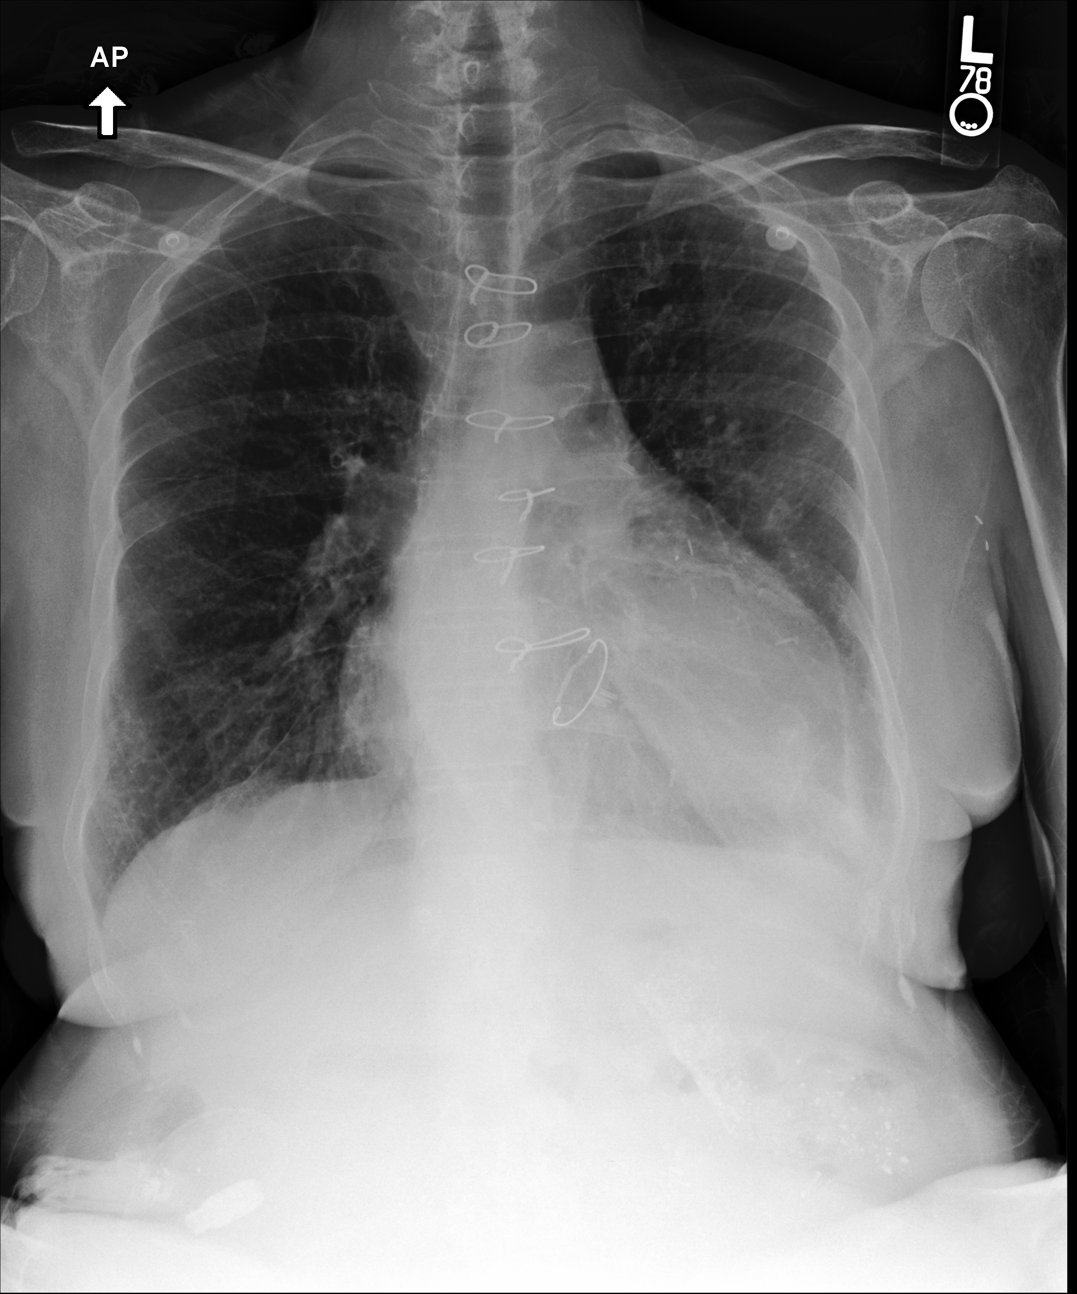
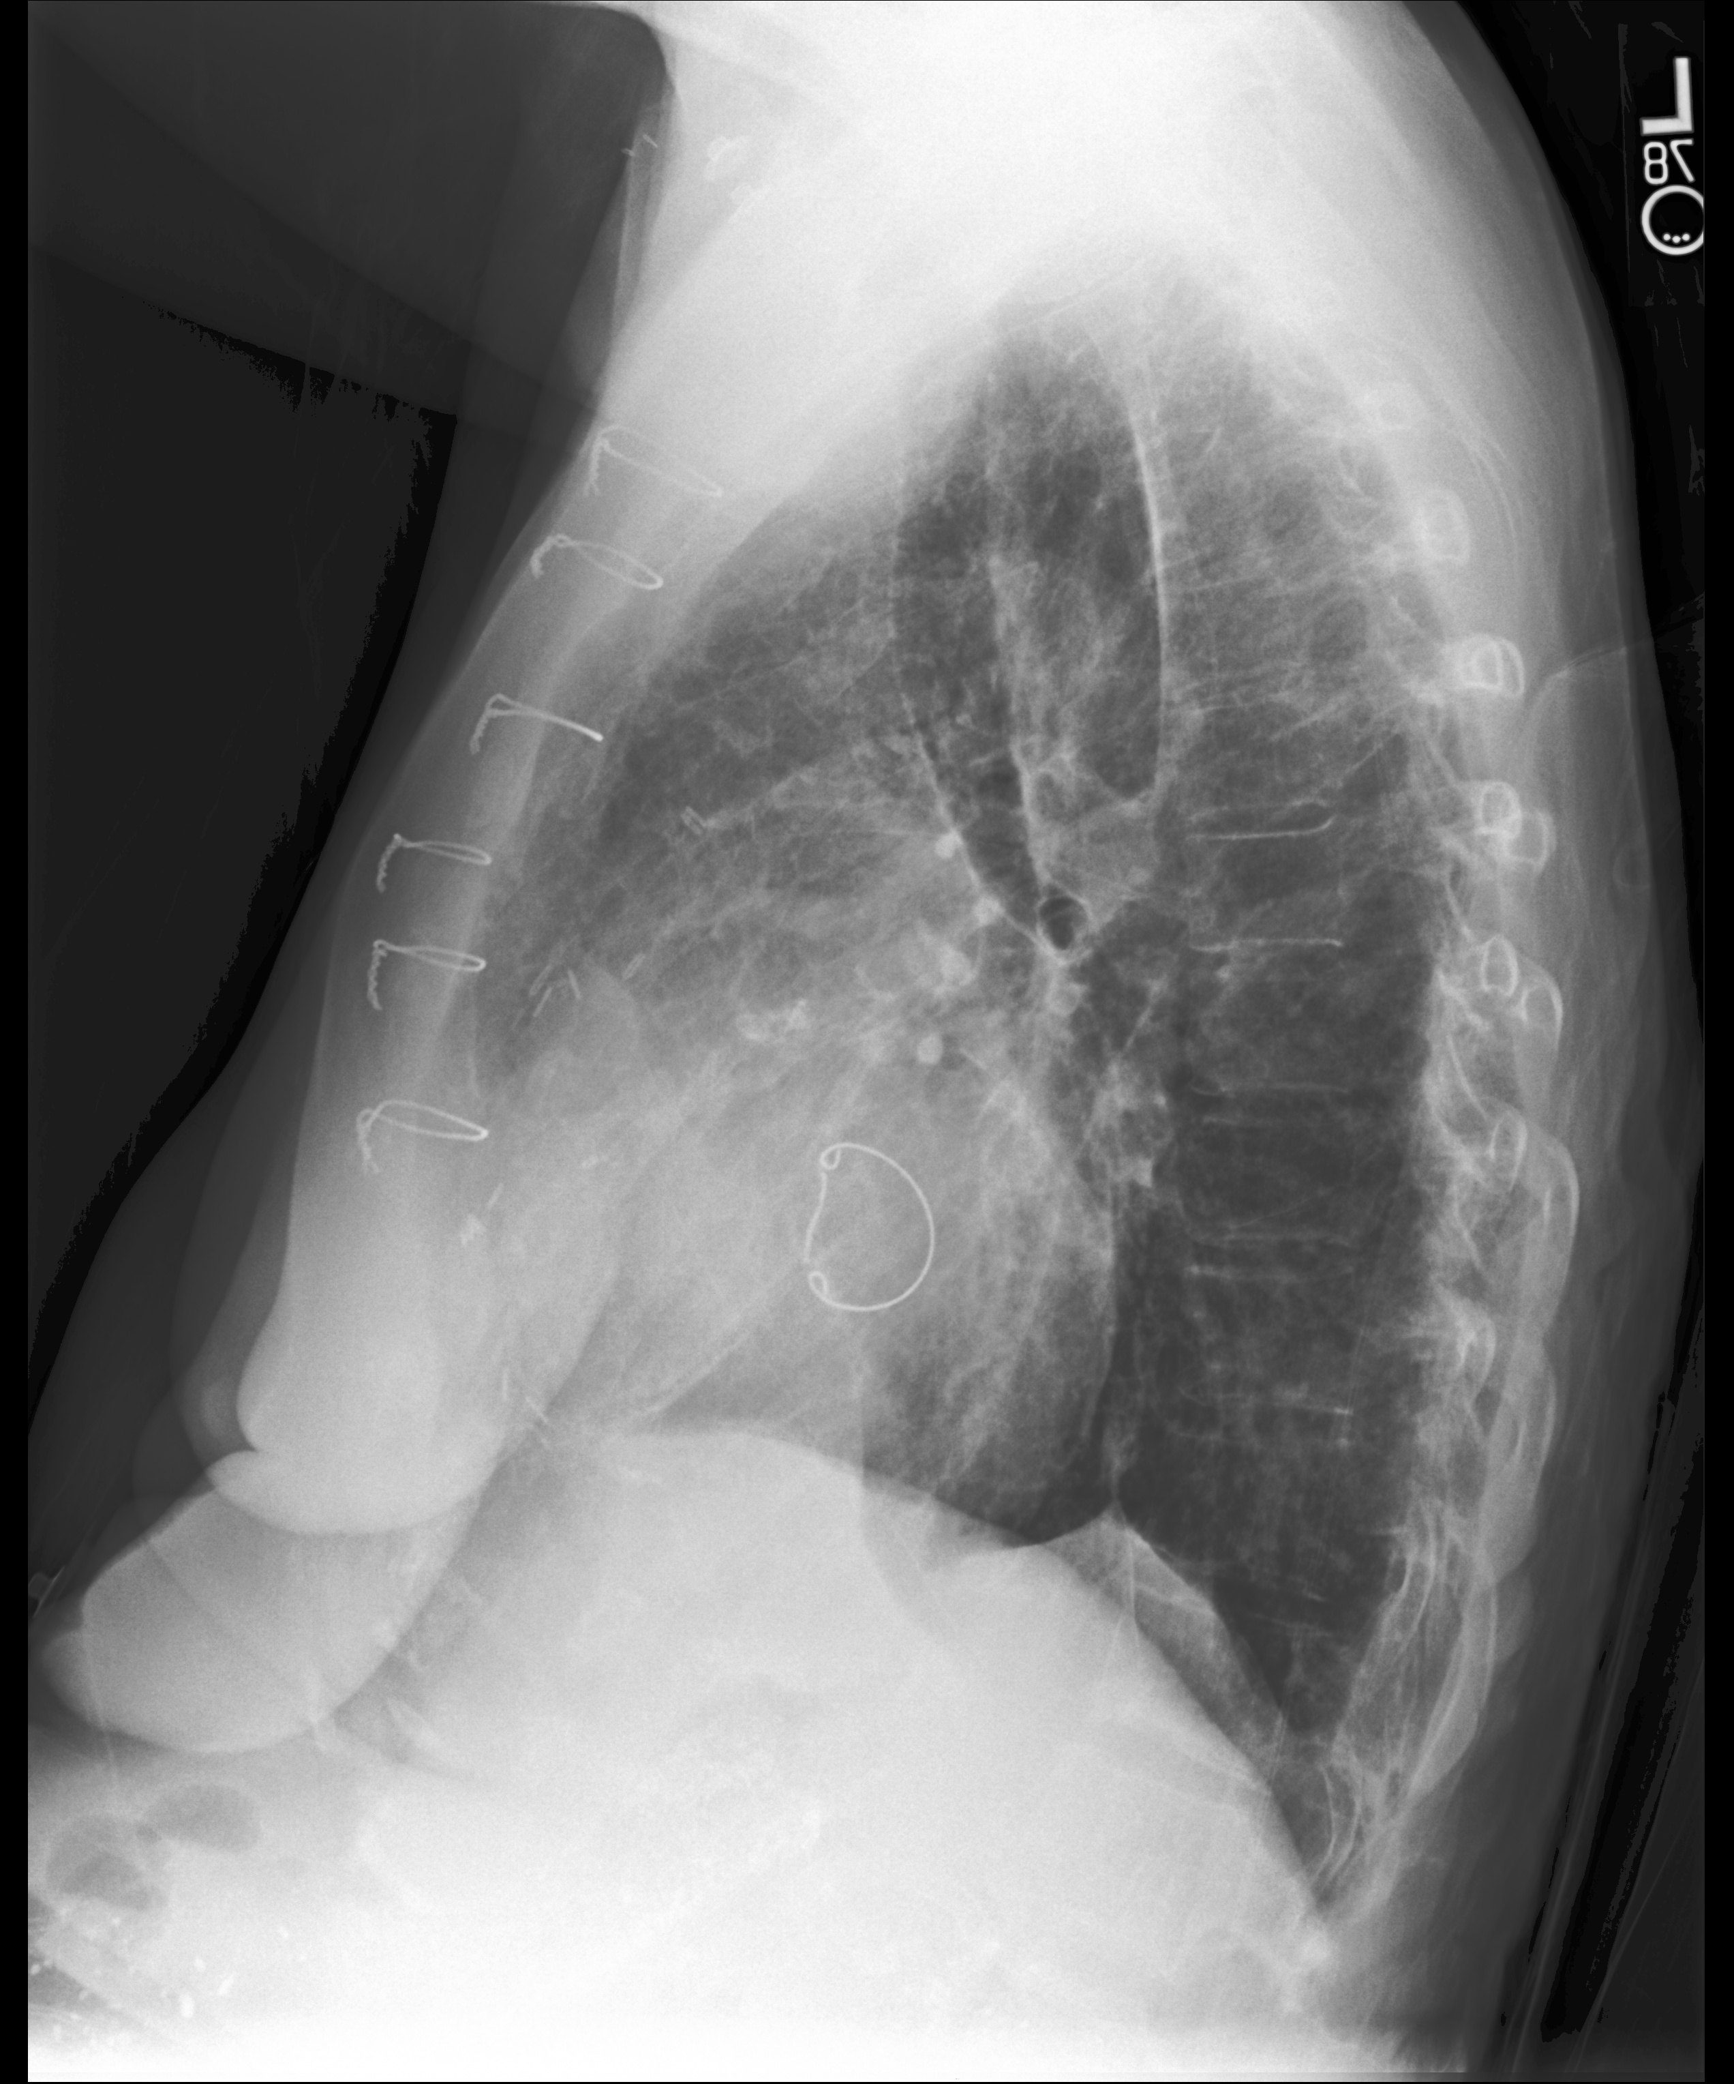
Task: automatic impression generation
Background: Technique: Chest, AP and lateral. Comparison: _ and _. History: Weakness and decreased blood sugar with leg swelling and tenderness.
Findings: The patient is status post coronary artery bypass graft surgery and apparently mitral valve replacement. The heart is mildly enlarged. The mediastinal and hilar contours appear unchanged. There is a slight interstitial abnormality, suggestive of a state of very mild congestion, but no new focal opacity. A left-sided pleural effusion has resolved although mild scarring or atelectasis persists. Bones are probably demineralized.
Impression: Findings suggesting mild pulmonary congestion. Resolution of small left-side pleural effusion.
Slide inspired by Sean MacAvaney: https://smac.pub/slides/sigir2019-radsum.pdf
Notes:
I’ll start by explaining the task…
Radiologist often have to write a report based on a radiograph.

Slide 3
Task: automatic impression generation
Background: Technique: Chest, AP and lateral. Comparison: _ and _. History: Weakness and decreased blood sugar with leg swelling and tenderness.
Findings: The patient is status post coronary artery bypass graft surgery and apparently mitral valve replacement. The heart is mildly enlarged. The mediastinal and hilar contours appear unchanged. There is a slight interstitial abnormality, suggestive of a state of very mild congestion, but no new focal opacity. A left-sided pleural effusion has resolved although mild scarring or atelectasis persists. Bones are probably demineralized.
Impression: Findings suggesting mild pulmonary congestion. Resolution of small left-side pleural effusion.
Information about the patients’ condition and the procedure.
Detailed description of imaging observations. Positive and negative findings.
Summary of the most important observations.
Typically 1/3 of the findings length.
Slide inspired by Sean MacAvaney: https://smac.pub/slides/sigir2019-radsum.pdf

Slide 4
Task: automatic impression generation
Background: Technique: Chest, AP and lateral. Comparison: _ and _. History: Weakness and decreased blood sugar with leg swelling and tenderness.
Findings: The patient is status post coronary artery bypass graft surgery and apparently mitral valve replacement. The heart is mildly enlarged. The mediastinal and hilar contours appear unchanged. There is a slight interstitial abnormality, suggestive of a state of very mild congestion, but no new focal opacity. A left-sided pleural effusion has resolved although mild scarring or atelectasis persists. Bones are probably demineralized.
Impression: Findings suggesting mild pulmonary congestion. Resolution of small left-side pleural effusion.
Writing the impression is both
extractive (selecting findings), and
abstractive (forming a concise conclusion)
Slide inspired by Sean MacAvaney: https://smac.pub/slides/sigir2019-radsum.pdf

Slide 5
Research contributions
Abstractive summarization is difficult to control, prone to hallucination
Proposal: extractive summaries as guidance (cheap, domain-agnostic)
1
Automatic eval (ROUGE, …) suggests progress. What problems remain?
Manual error analysis of (un)guided methods
2
Notes:
In this work, we make two contributions:
The first one is with respect to abstractive summarization that suffers from hallucinations: In this regard, we investigate the use of extractive summaries as guidance, and show that using variable-length guidance, which is domain-agnostic and cheap to produce is an alternative to the more expensive domain-specific guidance.
In the second part of this work, we go beyond the automatic metrics for this task and conduct a manual error analysis of the guided and unguided summarization methods.

Slide 6
Guided summarization framework
1. Extractive summarization (k sents.)
e.g., BertExt
Radiology Report
Findings:
GSum architecture (Dou et al., NAACL2021)
Notes:
I’ll start by explaining extractive summarization and how its output is used as a guidance for guided methods

Slide 7
Guided summarization framework
1. Extractive summarization (k sents.)
e.g., BertExt
Radiology Report
Findings:
GSum architecture (Dou et al., NAACL2021)

Slide 8
Guided summarization framework
1. Extractive summarization (k sents.)
e.g., BertExt
2. Guided abstractive summarization
Findings
Guidance
Radiology Report
Findings:
Document Encoder
Guidance Encoder
Decoder
Guidance
Candidate Impression
GSum architecture (Dou et al., NAACL2021)

Slide 9
Fixed-length guidance signal for all reports is ineffective
Longer guidance improves recall,
but deteriorates overall quality
Hypothesis: effective guidance depends on intended target length
Guidance length
Notes:
In initial experiments, we notice that using a fixed-length guidance signal for all reports is not effective
And because target impressions differ with respect to their length. You can see the distribution on the figure on the right. A lot of the impressions are short, but we have a long tail of relatively long impressions.
This is why, we hypothesize that "effective guidance depends on the intended target length”
In other words, if we should generate longer impression then we should also use a longer guidance signal.

Slide 10
Variable-length extractive summaries as guidance
Fixed-length extractive (Liu & Lapata, 2019)
Obtain training labels from oracle
Train binary sentence-level classifier
Pick top-k sentences (for all docs)
Fixed
Variable
s_{i} | ROUGE Oracle | BertExt p(y = 1|s_{i}) | Top-k (k=3)
1 |  | 0.1
2 | x | 0.9 | x
3 | x | 0.4 | x
4 |  | 0.1
5 |  | 0.2 | x
Thresholding (e.g., T ≥ 0.4) | Oracle Approx
x | x
x | x
Method 1: thresholding (ours)
Pick all sents with ≥ T, rather than top-k
Learn T from val. set
Method 2: oracle approximation (ours)
Learn classifier f(x) ➝ k
Training labels is ROUGE Oracle
Example doc (5 sentences)
Notes:
This is why we turn to variable-length guidance
But first let’s talk about fixed-length guidance...

Slide 11
Evaluation on two real world radiology datasets
Chest x-rays
 | MIMIC-CXR | OpenI
Instances | 122,500 / 963 / 1,598 | 2,342 / 334 / 670
Avg. Finding length | 56 tokens | 37 tokens
Avg. Impression length | 15 tokens | 8 tokens
Novelty (unigram) | 73.4% | 86.8%
Johnson et al. (2019). https://mimic.mit.edu/
Demner-Fushman et al. (2015). https://openi.nlm.nih.gov/
Notes:
[Can be left out if time is short]

Slide 13
Takeaways
Fixed-length guidance is worse than no guidance

Slide 14
Takeaways
Fixed-length guidance is worse than no guidance
Variable-length improves over unguided, competitive w/ domain-specific
Notes:
We generally find that variable-length methods perform comparably, with the threshold-based method being slightly better than the classifier-based ones

Slide 15
Takeaways
Fixed-length guidance is worse than no guidance
Variable-length improves over unguided, competitive w/ domain-specific
On more abstractive data (OpenI) no clear benefit
Notes:
We generally find that variable-length methods perform comparably, with the threshold-based method being slightly better than the classifier-based ones

Slide 16
Extractive guidance helps to generate longer summaries
ROUGE by target length (tokens)
Not effective
Effective
ROUGE-1
(no guidance)
(fixed-length)
(variable-length)
Notes:
To analyze where the improvement in performance comes from we look at which impressions benefit the most from the variable length summaries

Slide 17
So far…
Guided methods are effective according to automatic evaluation.
What problems remain?
Manual error analysis of (un)guided methods

Slide 18
Error analysis protocol (inspired by MQM)
Content categories
*
Omissions
Additions
100 reports
x 4 models
x 3 annotators
Factuality
* GSum w/ threshold (ours)
Extended from the taxonomy of Yu et al. (2022)
Notes:
For findings which both candidate/reference have in common, we capture factuality.

Slide 19
Most frequent errors are addition/omission of findings
Guided methods reduce risk of omissions
Category: “findings” | Omissions | Additions
BertAbs (unguided) | 70 | 51
GSum w/ threshold (ours) | 58 | 72
WGSum (Hu et al., 2021) | 62 | 61
WGSum+CL (Hu et al., 2022) | 64 | 54
Reference: Interval increase in vascular engorgement. No frank interstitial edema. No focal consolidations identified.
Candidate: interval increase in pulmonary vascular congestion without evidence of interstitial edema. small right-sided pleural effusion.
Majority of overlapping findings is factual!
Incorrect location (5-8%)
Incorrect severity (7-9%)
Reference: … there is near-complete resolution of pleural effusion
Candidate: … there is resolution of pleural effusion

Slide 20
Target impressions sometimes contain followups
Cannot be generated without clinical context
Category: “followups” | Omissions | Additions
BertAbs (unguided) | 20 | 5
GSum w/ threshold (ours) | 18 | 8
WGSum (Hu et al., 2021) | 19 | 8
WGSum+CL (Hu et al., 2022) | 19 | 4
Reference: Multiloculated right pleural effusion unchanged since _. […] Findings were relayed to Dr. _ by Dr. _ _ following review on _ at 11:00 via telephone.
Candidate: stable appearance of multiple loculated right pleural effusion.
Hallucinations!
Notes:
We see a similar trend across all models.
These followups are probably left out, becauase they are not mentioned in the findings section and can’t be generated without clinical text
Sometimes these are added by the models, but these are hallucinations
Could warrant cleaning of MIMIC-CXR dataset

Slide 21
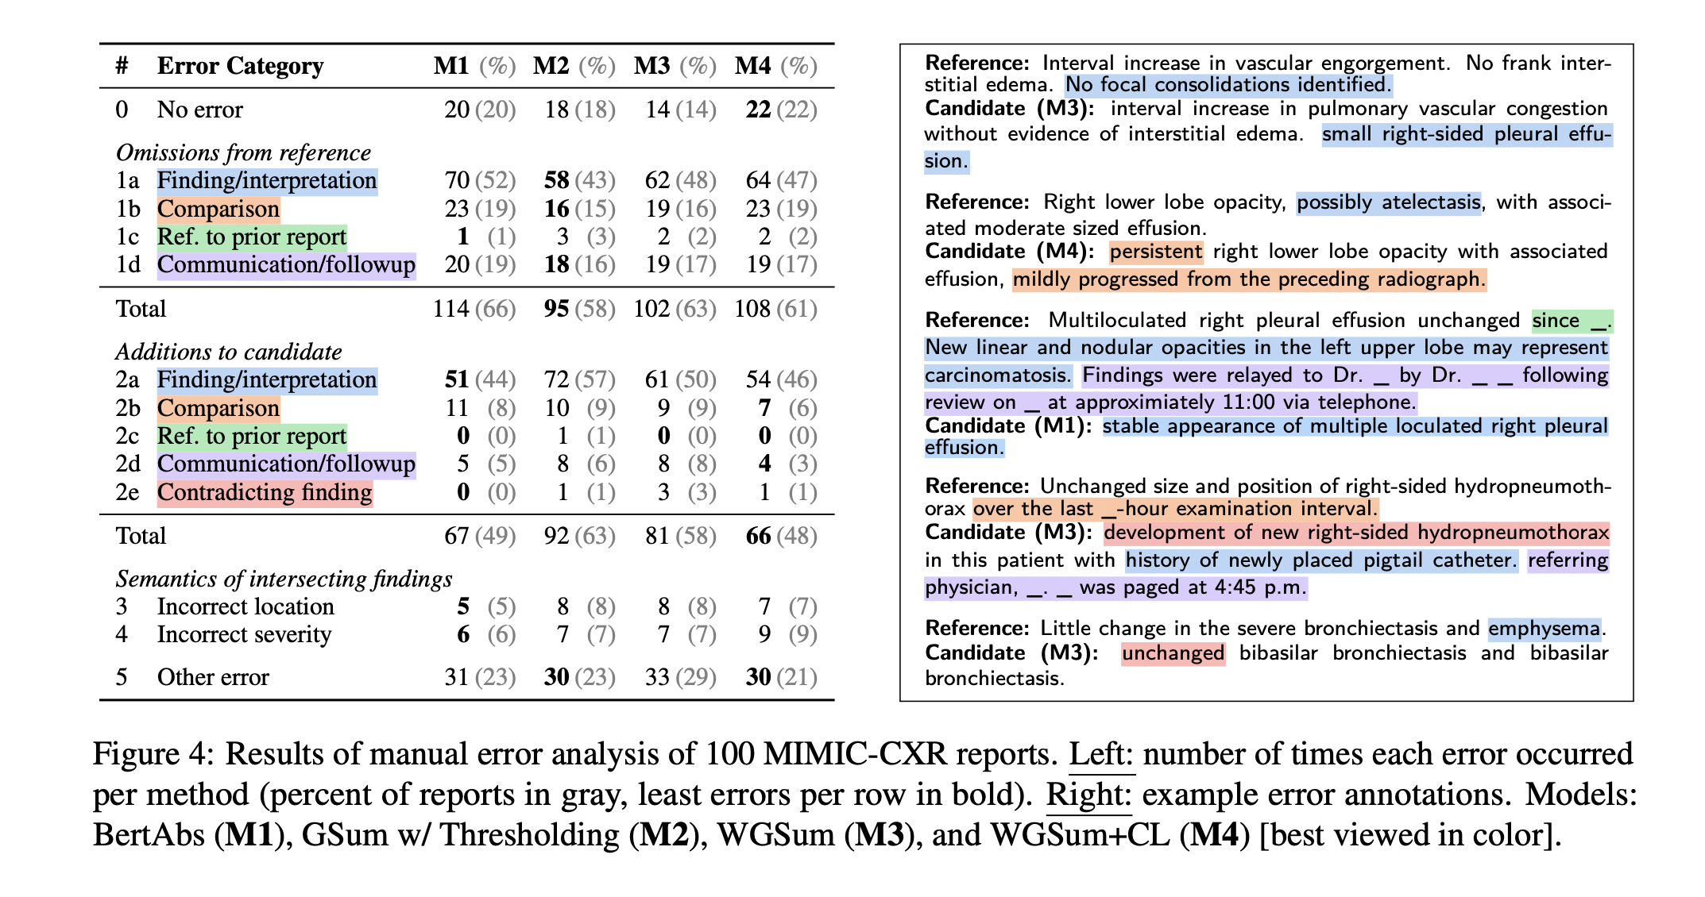
See the paper for all 11 categories and more examples…
Notes:
I invite to take a look at the paper to see all error categories along some examples in more detail

Slide 22
How to explain the problems in content selection?
Our ✨ hypothesis: ✨ models lack clinical context
Background: Technique: Chest, AP and lateral. Comparison: _ and _. History: Weakness and decreased blood sugar with leg swelling and tenderness.
Findings: The patient is status post coronary artery bypass graft surgery and apparently mitral valve replacement. The heart is mildly enlarged. The mediastinal and hilar contours appear unchanged. There is a slight interstitial abnormality, suggestive of a state of very mild congestion, but no new focal opacity. A left-sided pleural effusion has resolved although mild scarring or atelectasis persists. Bones are probably demineralized.
Impression: Findings suggesting mild pulmonary congestion. Resolution of small left-side pleural effusion.
Latent factors in reporting
Patient demographics
Chest x-ray (multimodal)
What happened after?
What happened before? Background section
Notes:
In general, there is a problem regarding selecting conent.

Slide 23
How to explain the problems in content selection?
Our ✨ hypothesis: ✨ models lack clinical context
Latent factors in reporting
Patient demographics
Chest x-ray (multimodal)
What happened before?
What happened after? Background section
Almost all methods benefit from including background
(delta over training without background)
Notes:
In general, we noticed that there is a problem with content selection.
We believe that this is due to the lack of clinical context.
sometimes latent factors that affect reporting are not available to the model.
Things such as…

Slide 24


Conclusion
Takeaways
Guided methods effective at steering content selection
Extractive summaries are useful guidance, if we adapt length to each document
Content selection issues remain – latent factors can explain some choices
Future work
Incorporate more clinical context (multimodal, EHR data, clinician in the loop?)
Benchmark and improve automatic metrics
We release our error annotations
Thanks!
github.com/jantrienes/inlg2023-radsum
jan.trienes@uni-due.de
paul.youssef@uni-marburg.de

Slide 25
Extra slides

Slide 26
Limitations of error analysis
Reference-based evaluation
Reference is most reliable benchmark for importance (w/o knowledge of clinical context)
Are additions faithful to findings?
Check addition spans for entailment with all input sentences.
Preliminary
Room for improvement in factuality
Include findings in future annotations
Miura et al. (2021). RadNLI
Notes:
Our error analysis has also some limitations:
We only use the reference impression when annotating.
In the absence of clinical context, we argue that this is the most reliable benchmark.
However, we also recognize that we can’t assess that factuality of additions without access to the findings section.
To achieve that, we use a natural language inference model for radiology reports (RadNLI), and check whether the additions can be entailed from or contradict the findings section.

Slide 27
Comparisons to prior studies also often added/omitted
Similar trend across all methods
Category: “comparisons" | Omissions | Additions
BertAbs (unguided) | 23 | 11
GSum w/ threshold (ours) | 16 | 10
WGSum (Hu et al., 2021) | 19 | 9
WGSum+CL (Hu et al., 2022) | 23 | 7
Reference: Right lower lobe opacity, possibly atelectasis, with associated moderate sized effusion.
Candidate: persistent right lower lobe opacity with associated effusion, mildly progressed from the preceding radiograph.
Notes:
[Can be left out if time is short]
Similar trends with respect to all models. We believe that these are due to background information that are not available to the model.

Slide 28
ROUGE oracle

Slide 29
Extractive guidance helps to generate longer summaries
ROUGE by target length (tokens)

Slide 30
Aggregating span-based annotation
First align, then majority vote

Slide 31
Inter-annotator agreement
F1 for span-based (1, 2)
Krippendorff’s alpha (3, 4)
(Due et al., 2021)

